Slide 1
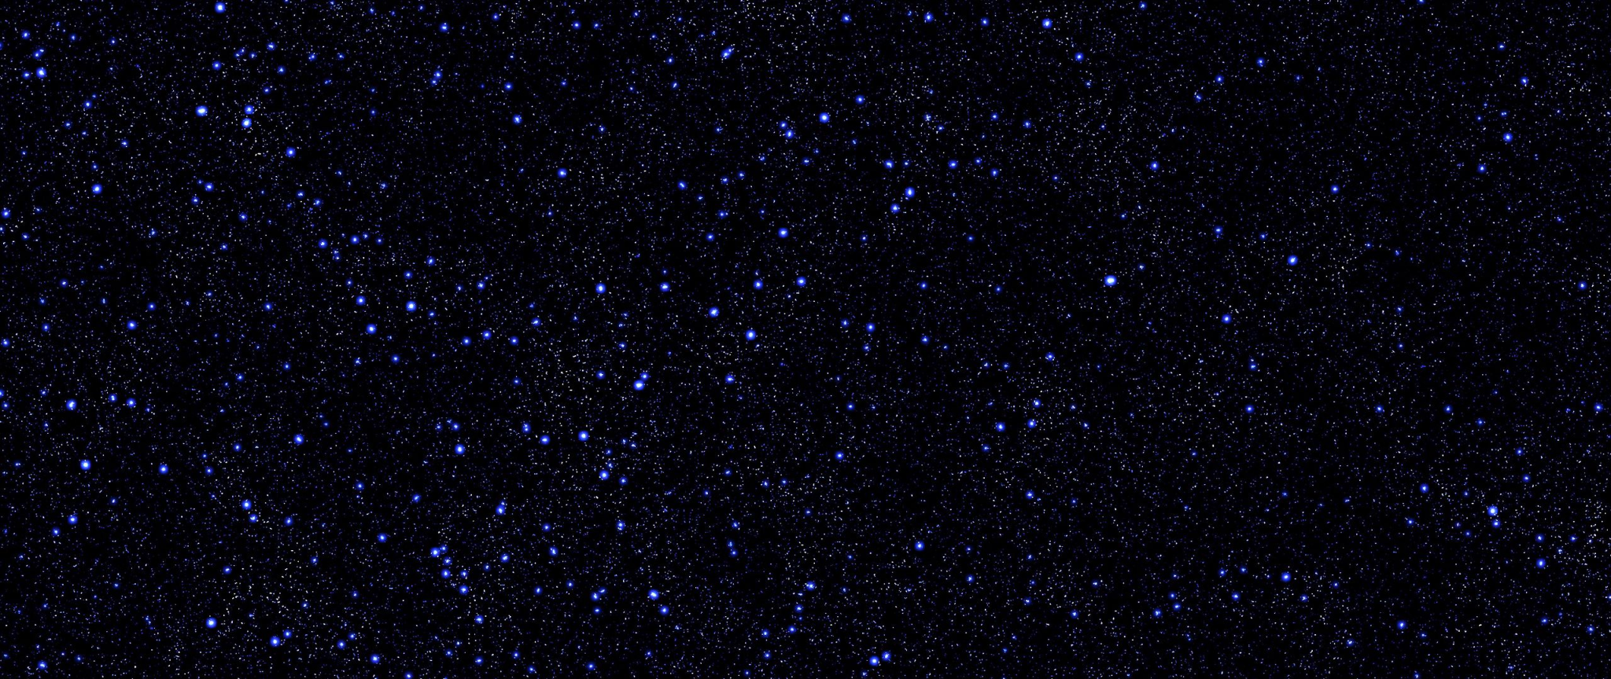
Star Wars Cosplay Database

Slide 2
Elevator pitch
Our Star Wars Cosplay Database is designed for anyone looking to create a realistic costume based off of a beloved Star Wars character! When visiting our site, simply click on a character and you will be given detailed information on them as well as links to Youtube videos for more costume inspiration! For added personalization, click on the ‘Faction’ option in the navigation bar to get a light and dark mode option for the site.
Notes:
Daniella

Slide 3
Concept
Description
This is a website meant for people who want more information about a Star Wars character so they can make a detailed costume for them. Users will see information such as hair color, eye color, gender, and height, as well as Youtube links to videos about costumes for that person.
Motivation for development?
Our motivation for developing this project was that we wanted to create a place where anyone can come to get extra help with finding information on Star Wars characters so they can make the best (and most accurate) costumes.
User story
AS A person who needs to make a Star Wars themed costume,
I WANT a website that I can go to to find more information about Star Wars characters,
SO THAT I can create the best and most accurate costume for those characters.
Notes:
Kenny

Slide 4
Process
Challenges
Figuring out the best way to implement the correct Youtube API without using the features that cost money
Implementation of local storage
Merge conflicts
Successes
Bulma implementation
Character picture / button functionality
Debugged deployment
Light & dark mode / modal
Youtube API Implementation
Technologies used
Javascript
Bulma CSS
HTML
Breakdown of tasks and roles
Main page CSS styling & Bulma + merge conflicts- Kenny
Light/Dark feature, modal, local storage, API result styling, and modal functionality - Daniella
About & Contact pages, Star Wars and Youtube API functionality - Aubrey
Main page content- Flora
Notes:
Technologies: kenny
Breakdown: aubrey
Challenges: daniella

Slide 5
Demo
https://florabernardo62.github.io/starwarsdatabase/
Notes:
Flora

Slide 6
Directions for Future Development
Features we would like to include in the future:
More characters to the database
Voice recording of each character to be played when clicked
Captions/quotes for each of the characters
More information on each character
Notes:
Aubrey

Slide 7
Links
Deployed = https://florabernardo62.github.io/starwarsdatabase/
GitHub repo = https://github.com/florabernardo62/starwarsdatabase

